Slide 1


Personal Finance: Build your budget!
Make smart money decisions to reach your savings goals ☺

Slide 2


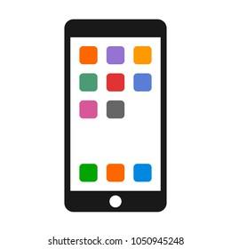

Monthly Income
Potential Monthly Expenditures
You work part-time at a local grocery store and make and income of $500 per month!
(Annually you could make $6000)
$50 on food at restaurants
$35 on a new limited edition video game
$80 on new clothes
$45 on new school supplies
$100 on school field trip
$60 on a gift for your friend
$130 to upgrade your phone
$10 music streaming subscription
$15 video streaming subscription
$100 on playing on a sports team

Slide 3
Step 1: Determine your needs and wants from the potential monthly expenditures! List the expenditures in the box and calculate how much you are willing to spend on in category and insert the total in the box. Think carefully about which expenditures that you may encounter in the month. (You may choose not to spend on some expenditures.)
NEEDS
WANTS
Total ($)
Total ($)

Slide 4

Step 2: Now let’s think about your savings! Using your total from your needs and wants, calculate how much you are putting into your savings.
Remember the 50/30/20 rule! But think carefully about your decision. You may choose to save more now, which may be beneficial for you in the long run.
SAVE
Income - (total needs + wants) = savings
Total ($)
Step 3: You want to save for college! You invest your money in an account with an interest rate of 4%-8%
Use this spreadsheet to calculate how much you could save over a period of 10-60 years.
Enter the value from Step 2 into the yellow box on the spreadsheet “Amount Saved Each Month ($)”
How much do you save after 60 years? (Amount Saved)
Notes:
https://1drv.ms/x/s!AvZPvdV0A7r3ggipHCoqZlduCmpE?e=bhkthT

